Slide 1


Linking On-line Written Word Recognition Processes with Reading Outcomes in Early Readers
Charlotte Jeppsen, Keith Baxelbaum,
Jamie Klein-Packard & Bob McMurray

Slide 2
Acknowledgments
Leah Zimmerman, Alex Fell, Abby Fergus, Emily Phalen, Sneh Jhaveri, Signy Wegener, Bruce Tomblin
Notes:
Leah Zimmerman
Alex Fell
Emily Phalen
Abby Fergus

Slide 3

Children Need to Read Efficiently
Notes:
Fluency doesn’t tell us what parts of the system are fast or slow. What are the parts? Let’s take the simple view.

Slide 4
Children Need to Read Efficiently
What does efficiency mean, really?
Notes:
Fluency doesn’t tell us what parts of the system are fast or slow. What are the parts? Let’s take the simple view.

Slide 5
Children Need to Read Efficiently
Fluency

Slide 6
Children Need to Read Efficiently
Fluency → Better Comprehension (Adams, 1990; Fuchs et al., 2001; NICHD, 2000)

Slide 7
Fluency is Broad

Slide 8
Fluency is Broad
Fluency assessments capture many things

Slide 9
Fluency is Broad
Fluency assessments capture many things
  Language skills

Slide 10
Fluency is Broad
Fluency assessments capture many things
  Language skills
  Processing speed

Slide 11
Fluency is Broad
Fluency assessments capture many things
  Language skills
  Processing speed
  Meta-cognitive strategies, etc.

Slide 12
Fluency is Broad
Fluency assessments capture many things
  Language skills
  Processing speed
  Meta-cognitive strategies, etc.
One concern: articulation

Slide 13
Fluency is Broad
Fluency assessments capture many things
  Language skills
  Processing speed
  Meta-cognitive strategies, etc.
One concern: articulation
  Skilled reading is often silent

Slide 14
Fluency is Broad
Fluency assessments capture many things
  Language skills
  Processing speed
  Meta-cognitive strategies, etc.
One concern: articulation
  Skilled reading is often silent
  Articulation skills develop through adolescence! (Smith & Zelaznik, 2004)

Slide 15
Fluency is Broad
Fluency assessments capture many things
  Language skills
  Processing speed
  Meta-cognitive strategies, etc.
One concern: articulation
  Skilled reading is often silent
  Articulation skills develop through adolescence! (Smith & Zelaznik, 2004)
Fluency doesn’t help us understand the breakdown of efficiency.

Slide 16
Fluency is an Outcome of Efficiency, Not a Contributor

Slide 17
Fluency is an Outcome of Efficiency, Not a Contributor
We need to understand the parts of efficiency in order to determine where/how it breaks down.

Slide 18
A Simple View: 2 Parts
Visual Word Recognition
Higher Level Language Processing
+
=
Reading

Slide 19
Efficiency Derives [in Part] from Automatic Lexical Access in the Simple View of Reading
Visual Word Recognition
Higher Level Language Processing
+
=
Reading

Slide 20
Efficiency Derives [in Part] from Automatic Lexical Access in the Simple View of Reading
Visual Word Recognition
Higher Level Language Processing
+
=
Reading
Efficiency can happen in multiple ways

Slide 21
Automatic Lexical Access:
Mapping Print → Meaning
CAT

Slide 22

Automatic Lexical Access:
Mapping Print → Meaning
CAT

Slide 23
Automatic Lexical Access:
Mapping Print → Phonology → Meaning
CAT
/kæt/
Notes:
If either of these processes are fast, you can be efficient. Not necessarily how it is achieved, just the process of being efficient. For today’s purposes, we will collapse these.

Slide 24
Automatic Lexical Access:
Mapping Print → Phonology → Meaning
CAT
/kæt/
How can we index efficient lexical access?
Notes:
If either of these processes are fast, you can be efficient. Not necessarily how it is achieved, just the process of being efficient. For today’s purposes, we will collapse these.

Slide 25
Visual World Paradigm (VWP) Captures Dynamics of Efficient Lexical Access in Spoken Words
(Cooper, 1974; Tanenhaus et al., 1995)

Slide 26
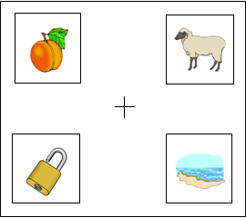
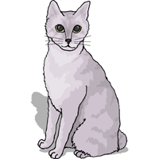


Visual World Paradigm (VWP) Captures Dynamics of Efficient Lexical Access in Spoken Words
(Cooper, 1974; Tanenhaus et al., 1995)
Target: Can
Competitor: Cat
Rhyme: Ran
Unrelated: Bag

Slide 27
0.9
Ca…
0.8
0.7
0.6
0.5
Fixation Proportion
0.4
0.3
0.2
0.1
0
0
500
1000
1500
2000
Time (ms)
  Amount and duration of fixations show processes involved

Slide 28
0.9
Ca…
0.8
0.7
0.6
0.5
Fixation Proportion
0.4
0.3
0.2
0.1
0
0
500
1000
1500
2000
Time (ms)
  Amount and duration of fixations show processes involved

Slide 29
0.9
Ca…
t
0.8
0.7
0.6
0.5
Fixation Proportion
0.4
0.3
0.2
0.1
0
0
500
1000
1500
2000
Time (ms)
  Amount and duration of fixations show processes involved

Slide 30
VWP Captures Written Lexical Access (Hendrickson et al., 2022; Apfelbaum et al., 2022; Gregg et al., 2023)

Slide 31
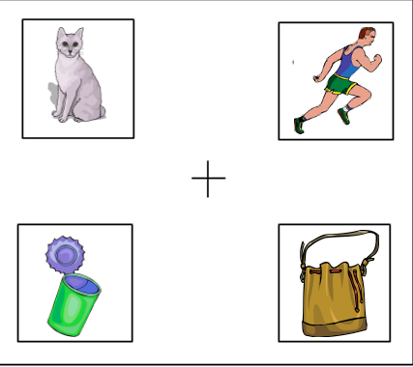
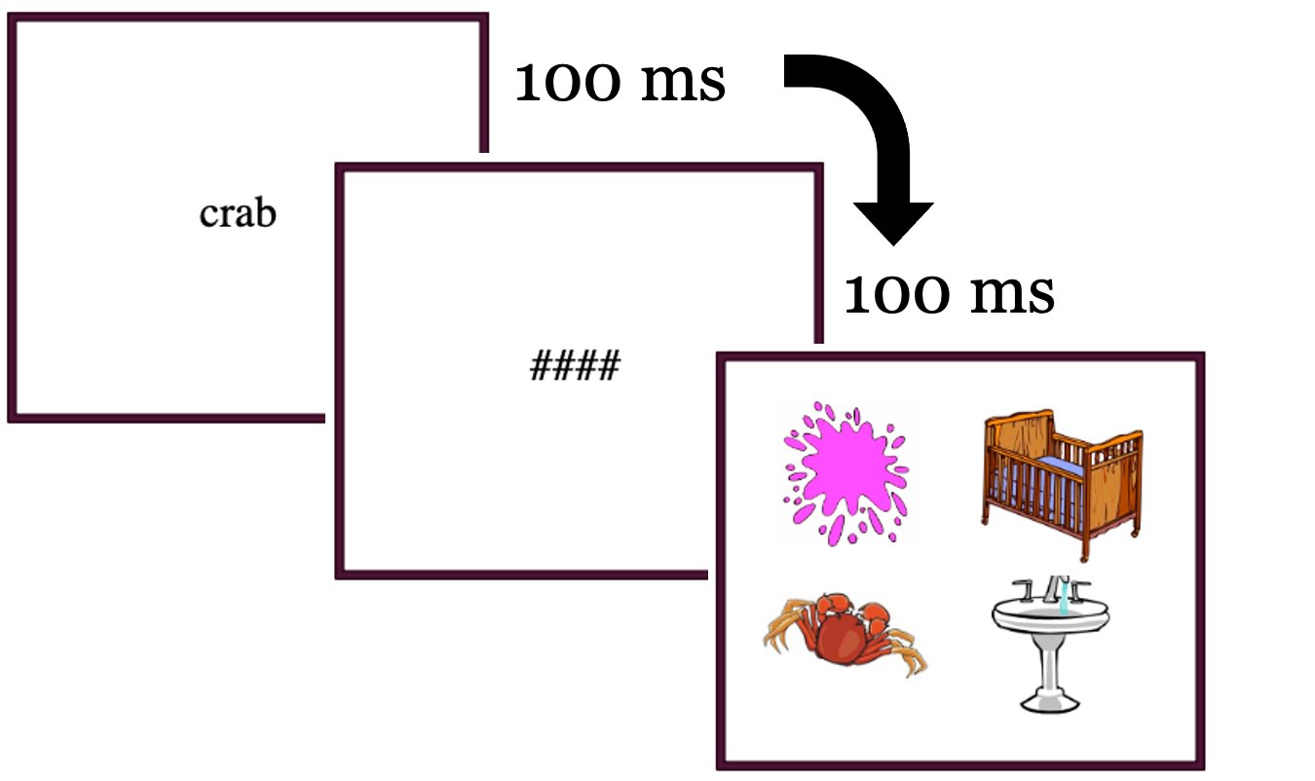
VWP Captures Written Lexical Access
CAN
can

Slide 32
Written Lexical Processing Develops
(Apfelbaum et al., 2022)

Slide 33
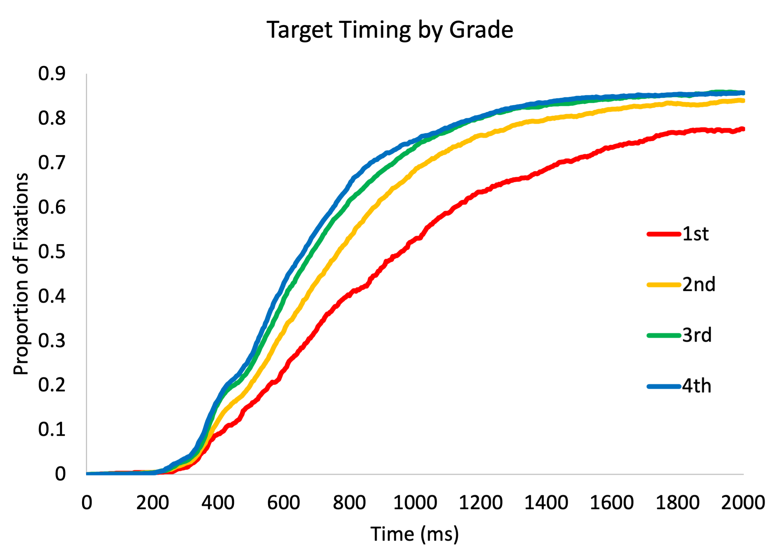
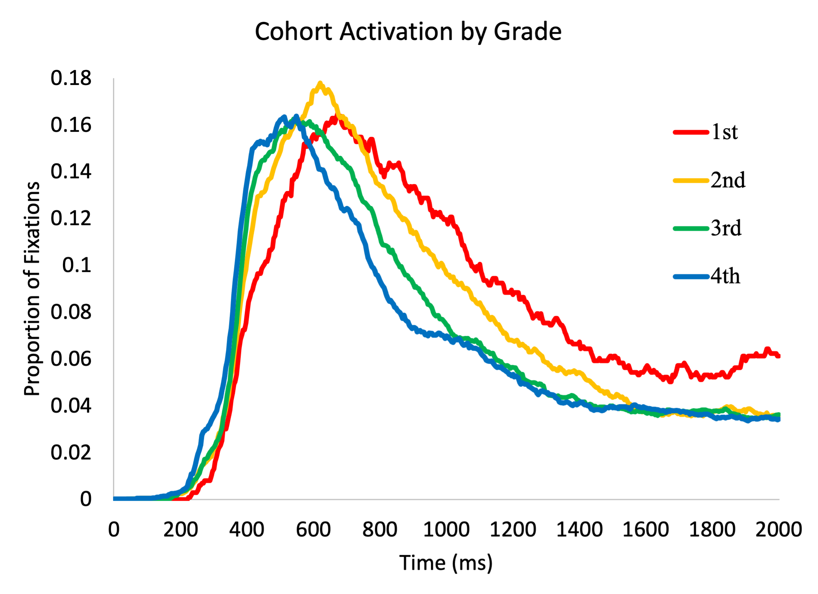
Written Lexical Processing Develops
Grade | N
1 | 25
2 | 66
3 | 85
4 | 82
Total | 258
Timecourse of Target Fixations By Grade
Timecourse of Cohort Fixations By Grade

Slide 34
To What Extent Does Efficient Lexical Access Drive Changes in Real-World Reading Behavior?

Slide 35
What’s the Link to Real-World Reading Behavior?
Need to map experimental measures to a tangible process

Slide 36
Reading Speed is One Real-World Behavior

Slide 37
Reading Speed is One Real-World Behavior
What is an alternative way to index speed, besides fluency?

Slide 38
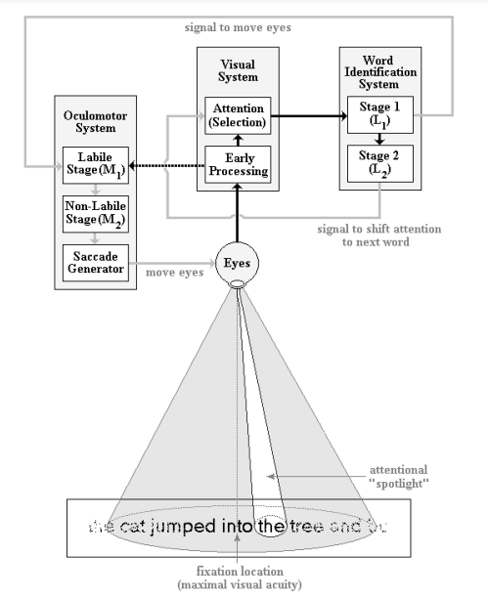
Eye-Movements Capture Reading Speed
(Reichle et al., 2003)

Slide 39
Eye-Movements Capture Reading Speed
Capture timing differences without requiring a verbal response or other skills
(Reichle et al., 2003)

Slide 40
Eye-Movements Capture Reading Speed
Capture timing differences without requiring a verbal response or other skills
Timing differences indicate cognitive constructs
(Reichle et al., 2003)

Slide 41
Eye-Movements Capture Reading Speed
Capture timing differences without requiring a verbal response or other skills
Timing differences indicate cognitive constructs
  It captures which cognitive operations were the bottleneck of those timing differences.
(Reichle et al., 2003)

Slide 42
Eye-Movements Capture Reading Speed
Lexical Access
The girl plays with her dog. Her dog is brown. She likes to play ball with her dog. Her mom gave her the dog.

Slide 43
Eye-Movements Capture Reading Speed
Lexical Access
  First Fixation (FD)
The girl plays with her dog. Her dog is brown. She likes to play ball with her dog. Her mom gave her the dog.

Slide 44
Eye-Movements Capture Reading Speed
Lexical Access
  First Fixation (FD)
  Gaze Duration (GD) (Henderson et al., 1987; Inhoff, 1984; Inhoff & Radach, 1998; Rayner et al., 2005)
The girl plays with her dog. Her dog is brown. She likes to play ball with her dog. Her mom gave her the dog.

Slide 45
Eye-Movements Capture Reading Speed
Lexical Access
  First Fixation (FD)
  Gaze Duration (GD) (Henderson et al., 1987; Inhoff, 1984; Inhoff & Radach, 1998; Rayner et al., 2005)
Higher Level Processes
The girl plays with her dog. Her dog is brown. She likes to play ball with her dog. Her mom gave her the dog.

Slide 46
Eye-Movements Capture Reading Speed
Lexical Access
  First Fixation (FD)
  Gaze Duration (GD) (Henderson et al., 1987; Inhoff, 1984; Inhoff & Radach, 1998; Rayner et al., 2005)
Higher Level Processes
  Re-reading and Regressions (Frazier & Rayner, 1982; Radach et al., 2008; Radach & Kennedy, 2004; Rayner et al., 2006)
The girl plays with her dog. Her dog is brown. She likes to play ball with her dog. Her mom gave her the dog.

Slide 47
Eye-Movements Capture Reading Speed
Lexical Access
  First Fixation (FD)
  Gaze Duration (GD) (Henderson et al., 1987; Inhoff, 1984; Inhoff & Radach, 1998; Rayner et al., 2005)
Higher Level Processes
  Re-reading and Regressions (Frazier & Rayner, 1982; Radach et al., 2008; Radach & Kennedy, 2004; Rayner et al., 2006)
  Skip Rate (Rayner et al., 2005)
The girl plays with her dog. Her dog is brown. She likes to play ball with her dog. Her mom gave her the dog.

Slide 48
Eye-Movements Capture Reading Speed
Lexical Access
  First Fixation (FD)
  Gaze Duration (GD) (Henderson et al., 1987; Inhoff, 1984; Inhoff & Radach, 1998; Rayner et al., 2005)
Higher Level Processes
  Re-reading and Regressions (Frazier & Rayner, 1982; Radach et al., 2008; Radach & Kennedy, 2004; Rayner et al., 2006)
  Skip Rate (Rayner et al., 2005)
The girl plays with her dog. Her dog is brown. She likes to play ball with her dog. Her mom gave her the dog.

Slide 49
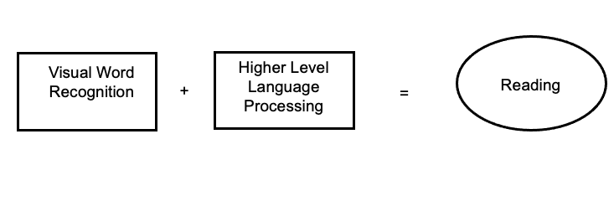
Eye-Movements Capture Reading Speed
Lexical Access
  First Fixation (FD)
  Gaze Duration (GD) (Henderson et al., 1987; Inhoff, 1984; Inhoff & Radach, 1998; Rayner et al., 2005)
Higher Level Processes
  Re-reading and Regressions (Frazier & Rayner, 1982; Radach et al., 2008; Radach & Kennedy, 2004; Rayner et al., 2006)
  Skip Rate (Rayner et al., 2005)
The girl plays with her dog. Her dog is brown. She likes to play ball with her dog. Her mom gave her the dog.

Slide 50
Eye-Movements Change with Development

Slide 51

Eye-Movements Change with Development
Kids become more efficient with age and experience (Kim et al. 2019, 2021, 2022)

Slide 52
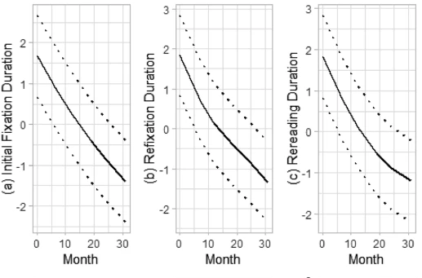
Eye-Movements Change with Development
Kids become more efficient with age and experience (Kim et al. 2019, 2021, 2022)
(Kim et al. 2022)

Slide 53
Eye-Movements Change with Development
Kids become more efficient with age and experience (Kim et al. 2019, 2021, 2022)
Fixation patterns are related to fluency
  Better fluency in Grade 1 → shorter gaze and re-reading duration at Grade 3 (Kim et al., 2021)
(Kim et al. 2022)

Slide 54
Do these Indices Change with Development?
Indices and Constructs in Development
  More fixations and regressions in grades 6-8 compared to younger kids (Spichtig et al., 2017)
  Maturational Reading Ability: Fixation duration
  Higher-Level Reading Challenges: Number of fixations and regressions

Slide 55
But Developmental Change Could Be Due to a Few Reasons
Shorter First Fixation Durations Could Derive From:

Slide 56
But Developmental Change Could Be Due to a Few Reasons
Shorter First Fixation Durations Could Derive From:
  Faster decoding

Slide 57
But Developmental Change Could Be Due to a Few Reasons
Shorter First Fixation Durations Could Derive From:
  Faster decoding
  More efficient lexical access

Slide 58
But Developmental Change Could Be Due to a Few Reasons
Shorter First Fixation Durations Could Derive From:
  Faster decoding
  More efficient lexical access
  Faster integration of the word into the discourse model

Slide 59
But Developmental Change Could Be Due to a Few Reasons
Shorter First Fixation Durations Could Derive From:
  Faster decoding
  More efficient lexical access
  Faster integration of the word into the discourse model
Regressions

Slide 60
But Developmental Change Could Be Due to a Few Reasons
Shorter First Fixation Durations Could Derive From:
  Faster decoding
  More efficient lexical access
  Faster integration of the word into the discourse model
Regressions
  Failure to recognize a word on the first pass

Slide 61
But Developmental Change Could Be Due to a Few Reasons
Shorter First Fixation Durations Could Derive From:
  Faster decoding
  More efficient lexical access
  Faster integration of the word into the discourse model
Regressions
  Failure to recognize a word on the first pass
  Syntactic parsing error

Slide 62
But Developmental Change Could Be Due to a Few Reasons
Shorter First Fixation Durations Could Derive From:
  Faster decoding
  More efficient lexical access
  Faster integration of the word into the discourse model
Regressions
  Failure to recognize a word on the first pass
  Syntactic parsing error
Skips

Slide 63
But Developmental Change Could Be Due to a Few Reasons
Shorter First Fixation Durations Could Derive From:
  Faster decoding
  More efficient lexical access
  Faster integration of the word into the discourse model
Regressions
  Failure to recognize a word on the first pass
  Syntactic parsing error
Skips
  Efficient language comprehension
To What Extent Do Eye-Movements Reflect Lexical Access?

Slide 64
Current Study
Aims to capture the breakdown and parts of efficient lexical access during reading at the individual level.

Slide 65
What Do These Indices Capture at the Individual Level?
Many claims about eye-tracking indices are based on variability in word-level factors, like frequency and length.

Slide 66
What Do These Indices Capture at the Individual Level?
Many claims about eye-movement indices are based on variability in word-level factors, like frequency and length.
Is there a way to more directly capture lexical access at the person level to better understand these mechanisms?

Slide 67
Current Study

Slide 68
Current Study
Grade | Number
2 | 43
3 | 73
4 | 74
Participants

Slide 69
Current Study
Grade | Number
2 | 43
3 | 73
4 | 74
Participants
  156 Monolingual Participants

Slide 70
Current Study
Grade | Number
2 | 43
3 | 73
4 | 74
Participants
  156 Monolingual Participants
  Range of Language and Reading Ability

Slide 71
Current Study
Grade | Number
2 | 43
3 | 73
4 | 74
Participants
  156 Monolingual Participants
  Range of Language and Reading Ability
  Year 2 of a Larger Longitudinal Project

Slide 72
Current Study
Grade | Number
2 | 43
3 | 73
4 | 74
Participants
  156 Monolingual Participants
  Range of Language and Reading Ability
  Year 2 of a Larger Longitudinal Project
Experiments

Slide 73
Current Study
The girl plays with her dog. Her dog is brown. She likes to play ball with her dog. Her mom gave her the dog.
Grade | Number
2 | 43
3 | 73
4 | 74
Participants
  156 Monolingual Participants
  Range of Language and Reading Ability
  Year 2 of a Larger Longitudinal Project
Experiments
  Fixations During Passage Reading

Slide 74
Current Study
The girl plays with her dog. Her dog is brown. She likes to play ball with her dog. Her mom gave her the dog.
Grade | Number
2 | 43
3 | 73
4 | 74
Participants
  156 Monolingual Participants
  Range of Language and Reading Ability
  Year 2 of a Larger Longitudinal Project
Experiments
  Fixations During Passage Reading
    Passages from the Test of Reading Comprehension-4

Slide 75
Current Study
The girl plays with her dog. Her dog is brown. She likes to play ball with her dog. Her mom gave her the dog.
Grade | Number
2 | 43
3 | 73
4 | 74
Participants
  156 Monolingual Participants
  Range of Language and Reading Ability
  Year 2 of a Larger Longitudinal Project
Experiments
  Fixations During Passage Reading
    Passages from the Test of Reading Comprehension-4
  Lexical Access

Slide 76
Current Study
The girl plays with her dog. Her dog is brown. She likes to play ball with her dog. Her mom gave her the dog.
Grade | Number
2 | 43
3 | 73
4 | 74
Participants
  156 Monolingual Participants
  Range of Language and Reading Ability
  Year 2 of a Larger Longitudinal Project
Experiments
  Fixations During Passage Reading
    Passages from the Test of Reading Comprehension-4
  Lexical Access
    VWP of Single Written Word Recognition

Slide 77
Current Study
The girl plays with her dog. Her dog is brown. She likes to play ball with her dog. Her mom gave her the dog.
Grade | Number
2 | 43
3 | 73
4 | 74
Participants
  156 Monolingual Participants
  Range of Language and Reading Ability
  Year 2 of a Larger Longitudinal Project
Experiments
  Fixations During Passage Reading
    Passages from the Test of Reading Comprehension-4
  Lexical Access
    VWP of Single Written Word Recognition
Outcome Measures

Slide 78
Current Study
The girl plays with her dog. Her dog is brown. She likes to play ball with her dog. Her mom gave her the dog.
Grade | Number
2 | 43
3 | 73
4 | 74
Participants
  156 Monolingual Participants
  Range of Language and Reading Ability
  Year 2 of a Larger Longitudinal Project
Experiments
  Fixations During Passage Reading
    Passages from the Test of Reading Comprehension-4
  Lexical Access
    VWP of Single Written Word Recognition
Outcome Measures
  Decoding

Slide 79
Current Study
The girl plays with her dog. Her dog is brown. She likes to play ball with her dog. Her mom gave her the dog.
Grade | Number
2 | 43
3 | 73
4 | 74
Participants
  156 Monolingual Participants
  Range of Language and Reading Ability
  Year 2 of a Larger Longitudinal Project
Experiments
  Fixations During Passage Reading
    Passages from the Test of Reading Comprehension-4
  Lexical Access
    VWP of Single Written Word Recognition
Outcome Measures
  Decoding
    Castles and Coltheart-2

Slide 80
Current Study
The girl plays with her dog. Her dog is brown. She likes to play ball with her dog. Her mom gave her the dog.
Grade | Number
2 | 43
3 | 73
4 | 74
Participants
  156 Monolingual Participants
  Range of Language and Reading Ability
  Year 2 of a Larger Longitudinal Project
Experiments
  Fixations During Passage Reading
    Passages from the Test of Reading Comprehension-4
  Lexical Access
    VWP of Single Written Word Recognition
Outcome Measures
  Decoding
    Castles and Coltheart-2
  Comprehension

Slide 81
Current Study
The girl plays with her dog. Her dog is brown. She likes to play ball with her dog. Her mom gave her the dog.
Grade | Number
2 | 43
3 | 73
4 | 74
Participants
  156 Monolingual Participants
  Range of Language and Reading Ability
  Year 2 of a Larger Longitudinal Project
Experiments
  Fixations During Passage Reading
    Passages from the Test of Reading Comprehension-4
  Lexical Access
    VWP of Single Written Word Recognition
Outcome Measures
  Decoding
    Castles and Coltheart-2
  Comprehension
    Gates-MacGinitie and Gray Oral Reading Comprehension

Slide 82
Current Study
The girl plays with her dog. Her dog is brown. She likes to play ball with her dog. Her mom gave her the dog.
Grade | Number
2 | 43
3 | 73
4 | 74
Participants
  156 Monolingual Participants
  Range of Language and Reading Ability
  Year 2 of a Larger Longitudinal Project
Experiments
  Fixations During Passage Reading
    Passages from the Test of Reading Comprehension-4
  Lexical Access
    VWP of Single Written Word Recognition
Outcome Measures
  Decoding
    Castles and Coltheart-2
  Comprehension
    Gates-MacGinitie and Gray Oral Reading Comprehension
  Language

Slide 83
Current Study
The girl plays with her dog. Her dog is brown. She likes to play ball with her dog. Her mom gave her the dog.
Grade | Number
2 | 43
3 | 73
4 | 74
Participants
  156 Monolingual Participants
  Range of Language and Reading Ability
  Year 2 of a Larger Longitudinal Project
Experiments
  Fixations During Passage Reading
    Passages from the Test of Reading Comprehension-4
  Lexical Access
    VWP of Single Written Word Recognition
Outcome Measures
  Decoding
    Castles and Coltheart-2
  Comprehension
    Gates-MacGinitie and Gray Oral Reading Comprehension
  Language
    Woodcock Johnson Vocabulary and CELF Recalling Sentences

Slide 84
Does Lexical Access Develop?
Do Eye-Movements Develop and Change With Outcomes?
What Are the Unique Predictors of Change in Eye-Movements?
To What Extent Are Eye-Movements Predicted by Lexical Access?
Are There Common Factors Underlying Eye-Movements?

Slide 85
Lexical Access Develops with Grade
Grade | N
1 | 25
2 | 66
3 | 85
4 | 82
Total | 258
Timecourse of Target Fixations By Grade

Slide 86
Target Timing
Slope
Crossover

Slide 87
Does Lexical Access Develop?
Do Eye-Movements Develop and Change With Outcomes?
What Are the Unique Predictors of Change in Eye-Movements?
To What Extent Are Eye-Movements Predicted by Lexical Access?
Are There Common Factors Underlying Eye-Movements?

Slide 88
First Fixation Duration Decreases with Decoding and Grade
R = -.23, p<.001
R = -.33, p<.001

Slide 89
Regressions Decrease with Grade and Language
R= -.27, p<.001
R= -.15, p<.05

Slide 90
Does Lexical Access Develop?
Do Eye-Movements Develop and Change With Outcomes?
What Are the Unique Predictors of Change in Eye-Movements?
To What Extent Are Eye-Movements Predicted by Lexical Access?
Are There Common Factors Underlying Eye-Movements?

Slide 91
Commonality Analyses to Parse Unique Effects

Slide 92
Commonality Analyses to Parse Unique Effects
What is the unique variance accounted for by

Slide 93
Commonality Analyses to Parse Unique Effects
What is the unique variance accounted for by
  Decoding

Slide 94
Commonality Analyses to Parse Unique Effects
What is the unique variance accounted for by
  Decoding
  Language

Slide 95
Commonality Analyses to Parse Unique Effects
What is the unique variance accounted for by
  Decoding
  Language
  Grade

Slide 96
Commonality Analyses to Parse Unique Effects
What is the unique variance accounted for by
  Decoding
  Language
  Grade
  Lexical Access (Visual Word Recognition)

Slide 97
Commonality Analyses to Parse Unique Effects
What is the unique variance accounted for by
  Decoding
  Language
  Grade
  Lexical Access (Visual Word Recognition)
What is the shared variance between these predictors?

Slide 98
Decoding and Grade Uniquely Predict First Fixation Duration
R^2
*
*
***
*
***
FFD: First Fixation Duration

Slide 99
Decoding Uniquely Predicts Other Timing Indices
R^2
*
*
***
*
***
*
FFD: First Fixation Duration
GD: Gaze Duration
TRT: Total Reading Time
Notes:
Shared with lexical access.

Slide 100
Decoding Also Predicts Regressions: Surprising!
R^2
*
*
***
*
***
*
GD: Gaze Duration
TRT: Total Reading Time
NR: Number of Regressions
RD: Regression Duration
Notes:
Shared with lexical access.

Slide 101
Skip Rate is a High-Level Process
R^2
*
*
***
*
***
*
GD: Gaze Duration
TRT: Total Reading Time
NR: Number of Regressions
RD: Regression Duration
SR: Skip Rate
Notes:
Shared with lexical access.

Slide 102
Does Lexical Access Develop?
Do Eye-Movements Develop and Change With Outcomes?
What Are the Unique Predictors of Change in Eye-Movements?
To What Extent Are Eye-Movements Predicted by Lexical Access?
Are There Common Factors Underlying Eye-Movements?

Slide 103
R^2
*
*
***
*
***
*
GD: Gaze Duration
TRT: Total Reading Time
NR: Number of Regressions
RD: Regression Duration
SR: Skip Rate
Notes:
Shared with lexical access.

Slide 104
Efficient Lexical Access Uniquely Predicts Many Processes
R^2
***
***
***
*
*
*
***
*
*
***
*
***
*
GD: Gaze Duration
TRT: Total Reading Time
NR: Number of Regressions
RD: Regression Duration
SR: Skip Rate
Notes:
Shared with lexical access.

Slide 105
Does Lexical Access Develop?
Do Eye-Movements Develop and Change With Outcomes?
What Are the Unique Predictors of Change in Eye-Movements?
To What Extent Are Eye-Movements Predicted by Lexical Access?
Are There Common Factors Underlying Eye-Movements?
ks

Slide 106
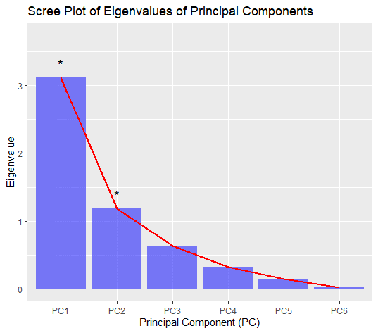
Eye-Movement Components Index Simple View Parts
Index | PC1 = Lexical Processing | PC2 = High-Level Efficiency
First Fixation Duration | .43 | -.42
Gaze Duration | .48 | .18
Total Reading Time | .48 | .25
Regression Duration | .43 | -.40
Number of Regressions | .40 | .28
Skip Rate | .05 | .70
Notes:
What percentage of variance the first two PCs account for.

Slide 107
Eye-Movement Components Index Simple View Parts
Index | PC1 = Lexical Processing | PC2 = High-Level Language
First Fixation Duration | .43 | -.42
Gaze Duration | .48 | .18
Total Reading Time | .48 | .25
Regression Duration | .43 | -.40
Number of Regressions | .40 | .28
Skip Rate | .05 | .70

Slide 108
Lexical Processing Component is Correlated with Decoding and Language
R = -.2, p<.001
R = -.4, p<.001

Slide 109
High-Level Language Component is Correlated with Better Comprehension
R = .15, p<.05

Slide 110
But Not With Decoding or Language
R = -.016, n.s.
R = .09, n.s.

Slide 111
Efficient Lexical Access is Correlated with Both Components
R = -.44, p<.001
R = .18, p<.02

Slide 112
Lexical Access and Decoding Uniquely Predict Lexical Processing
R^2

Slide 113
Lexical Access Does Not Predict Higher-Level Language
R^2

Slide 114
Conclusions

Slide 115
Conclusions
Eye-movement indices capture both lexical and high-level language processes – can be explained by Simple View

Slide 116
Conclusions
Eye-movement indices capture both lexical and high-level language processes – can be explained by Simple View
  Duration processes are lexical, while skipping is higher-level

Slide 117
Conclusions
Eye-movement indices capture both lexical and high-level language processes – can be explained by Simple View
  Duration processes are lexical, while skipping is higher-level
  Regressions reflect lexical processing!

Slide 118
Conclusions
Eye-movement indices capture both lexical and high-level language processes – can be explained by Simple View
  Duration processes are lexical, while skipping is higher-level
  Regressions reflect lexical processing!
These processes become tuned over development, and are affected by reading and language ability

Slide 119
Conclusions
Eye-movement indices capture both lexical and high-level language processes – can be explained by Simple View
  Duration processes are lexical, while skipping is higher-level
  Regressions reflect lexical processing!
These processes become tuned over development, and are affected by reading and language ability
  Children become more efficient with grade

Slide 120
Conclusions
Eye-movement indices capture both lexical and high-level language processes – can be explained by Simple View
  Duration processes are lexical, while skipping is higher-level
  Regressions reflect lexical processing!
These processes become tuned over development, and are affected by reading and language ability
  Children become more efficient with grade
  Better decoding → smaller durations and number of regressions

Slide 121
Conclusions
Eye-movement indices capture both lexical and high-level language processes – can be explained by Simple View
  Duration processes are lexical, while skipping is higher-level
  Regressions reflect lexical processing!
These processes become tuned over development, and are affected by reading and language ability
  Children become more efficient with grade
  Better decoding → smaller durations and number of regressions
  More skips → better language ability

Slide 122
Conclusions
Eye-movement indices capture both lexical and high-level language processes – can be explained by Simple View
  Duration processes are lexical, while skipping is higher-level
  Regressions reflect lexical processing!
These processes become tuned over development, and are affected by reading and language ability
  Children become more efficient with grade
  Better decoding → smaller durations and number of regressions
  More skips → better language ability
Efficient lexical access doubles the amount of variance in eye-movements (Roembke et al., 2019)

Slide 123
Take Home
Efficient lexical access underlies efficient reading!

Slide 124
Future Work
Longitudinal analyses to investigate within-subject level change of lexical access and reading
Interactions with frequency, word type, other lexical properties.

Slide 125
Questions?

Slide 126
Conclusions
  Lexical access and eye-movements become tuned across development
    Children become more efficient with grade
  Eye-movements change with decoding and language
    Better decoding → smaller durations and number of regressions
    Better language → more skips
    Both unique and shared effects of predictors contribute
  Efficient lexical access uniquely predicts changes with many eye-movements!
    Faster target timing → smaller durations and number of regressions
  Eye-movements index both lexical access and high-level components

